Slide 1

CS 61C: Great Ideas in Computer Architecture Lecture 24: More I/O: DMA, Disks, Networking
Instructor: Sagar Karandikar
sagark@eecs.berkeley.edu
http://inst.eecs.berkeley.edu/~cs61c

Slide 2
Review: I/O
Programmed I/O:
CPU execs lw/sw instructions for all data movement to/from devices
CPU spends time doing 3 things:
Getting data from device to main mem.
Using data to compute
Sending data back to main mem.
Polling
Interrupts

Slide 3
Working with real devices
Programmed I/O: DMA
CPU execs lw/sw instructions for all data movement to/from devices
CPU spends time doing 3 things:
Getting data from device to main mem.
Using data to compute
Sending data back to main mem.
Polling
Interrupts

Slide 4
Agenda
Direct Memory Access (DMA)
Disks
Networking

Slide 5
What’s wrong with Programmed I/O?
CPU has sole control over main memory
Not ideal since…
CPU has to execute all transfers, could be doing other work
Device speeds don’t align well with CPU speeds
Energy cost of using beefy general-purpose CPU where simpler hardware would suffice

Slide 6
Direct Memory Access (DMA)
Allows other devices to directly read/write from main memory
New Hardware: the DMA Engine
DMA engine contains registers written by CPU:
Memory address to place data
# of bytes
I/O port #, direction of transfer
unit of transfer, amount to transfer per burst

Slide 7
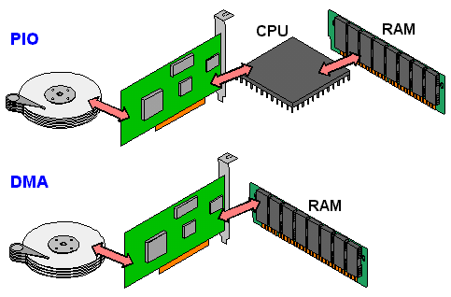
PIO vs. DMA

Slide 8
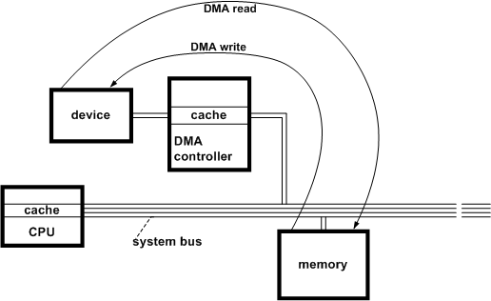
System with DMA

Slide 9
DMA: Incoming Data
Receive interrupt from device
CPU takes interrupt, begins transfer
Instructs DMA engine/device to place data @ certain address
Device/DMA engine handle the transfer
CPU is free to execute other things
Upon completion, Device/DMA engine interrupt the CPU again

Slide 10
DMA: Outgoing Data
CPU decides to initiate transfer, confirms that external device is ready
CPU begins transfer
Instructs DMA engine/device that data is available @ certain address
Device/DMA engine handle the transfer
CPU is free to execute other things
Device/DMA engine interrupt the CPU again to signal completion

Slide 11
DMA: Some new problems
Where in the memory hierarchy do we plug in the DMA engine? Two extremes:
Between L1 and CPU:
Pro: Free coherency
Con: Trash the CPU’s working set with transferred data
Between Last-level cache and main mem:
Pro: Don’t mess with caches
Con: Need to explicitly manage coherency

Slide 12
DMA: Some new problems
How do we arbitrate between CPU and DMA Engine/Device access to memory? Three options:
Burst Mode
Start transfer of data block, CPU cannot access mem in the meantime
Cycle Stealing Mode
DMA engine transfers a byte, releases control, then repeats - interleaves processor/DMA engine accesses
Transparent Mode
DMA transfer only occurs when CPU is not using the system bus

Slide 13
Administrivia
Project 4 out now
Competition for glory + EC, awards during last lecture
HW6 Out – VM, I/O, Parity, ECC
Guerrilla Section on VM, I/O, ECC, on Thursday from 5-7pm, Woz

Slide 14
Administrivia
Upcoming Lecture Schedule
8/04: I/O: DMA, Disks, Networking (today)
8/05: Dependability: Parity, ECC, RAID
Last day of new material
8/06: Final Exam Review, Fa14 Final
8/10: Final Exam Review, Sp15 Final
8/11: Summary, What’s Next? (+ HKN reviews)
Project 4 Competition Winners Announced
8/12: No Lecture, I’ll have OH in this room

Slide 15
Administrivia
Final Exam is next Thursday (8/13)
9am-12pm, 10 Evans
Three 8.5”x11”, double-sided, handwritten cheat-sheets
Broken into MT1 section, MT2 section, and post-MT2 section (so that the clobber can be applied)
TA Review Session: 08/09, 1-5pm, HP Aud.
In-class review: 08/06, 08/10

Slide 16
Agenda
Direct Memory Access (DMA)
Disks
Networking

Slide 17
Review - 6 Great Ideas in Computer Architecture
Layers of Representation/Interpretation
Moore’s Law
Principle of Locality/Memory Hierarchy
Parallelism
Performance Measurement & Improvement
Dependability via Redundancy

Slide 18
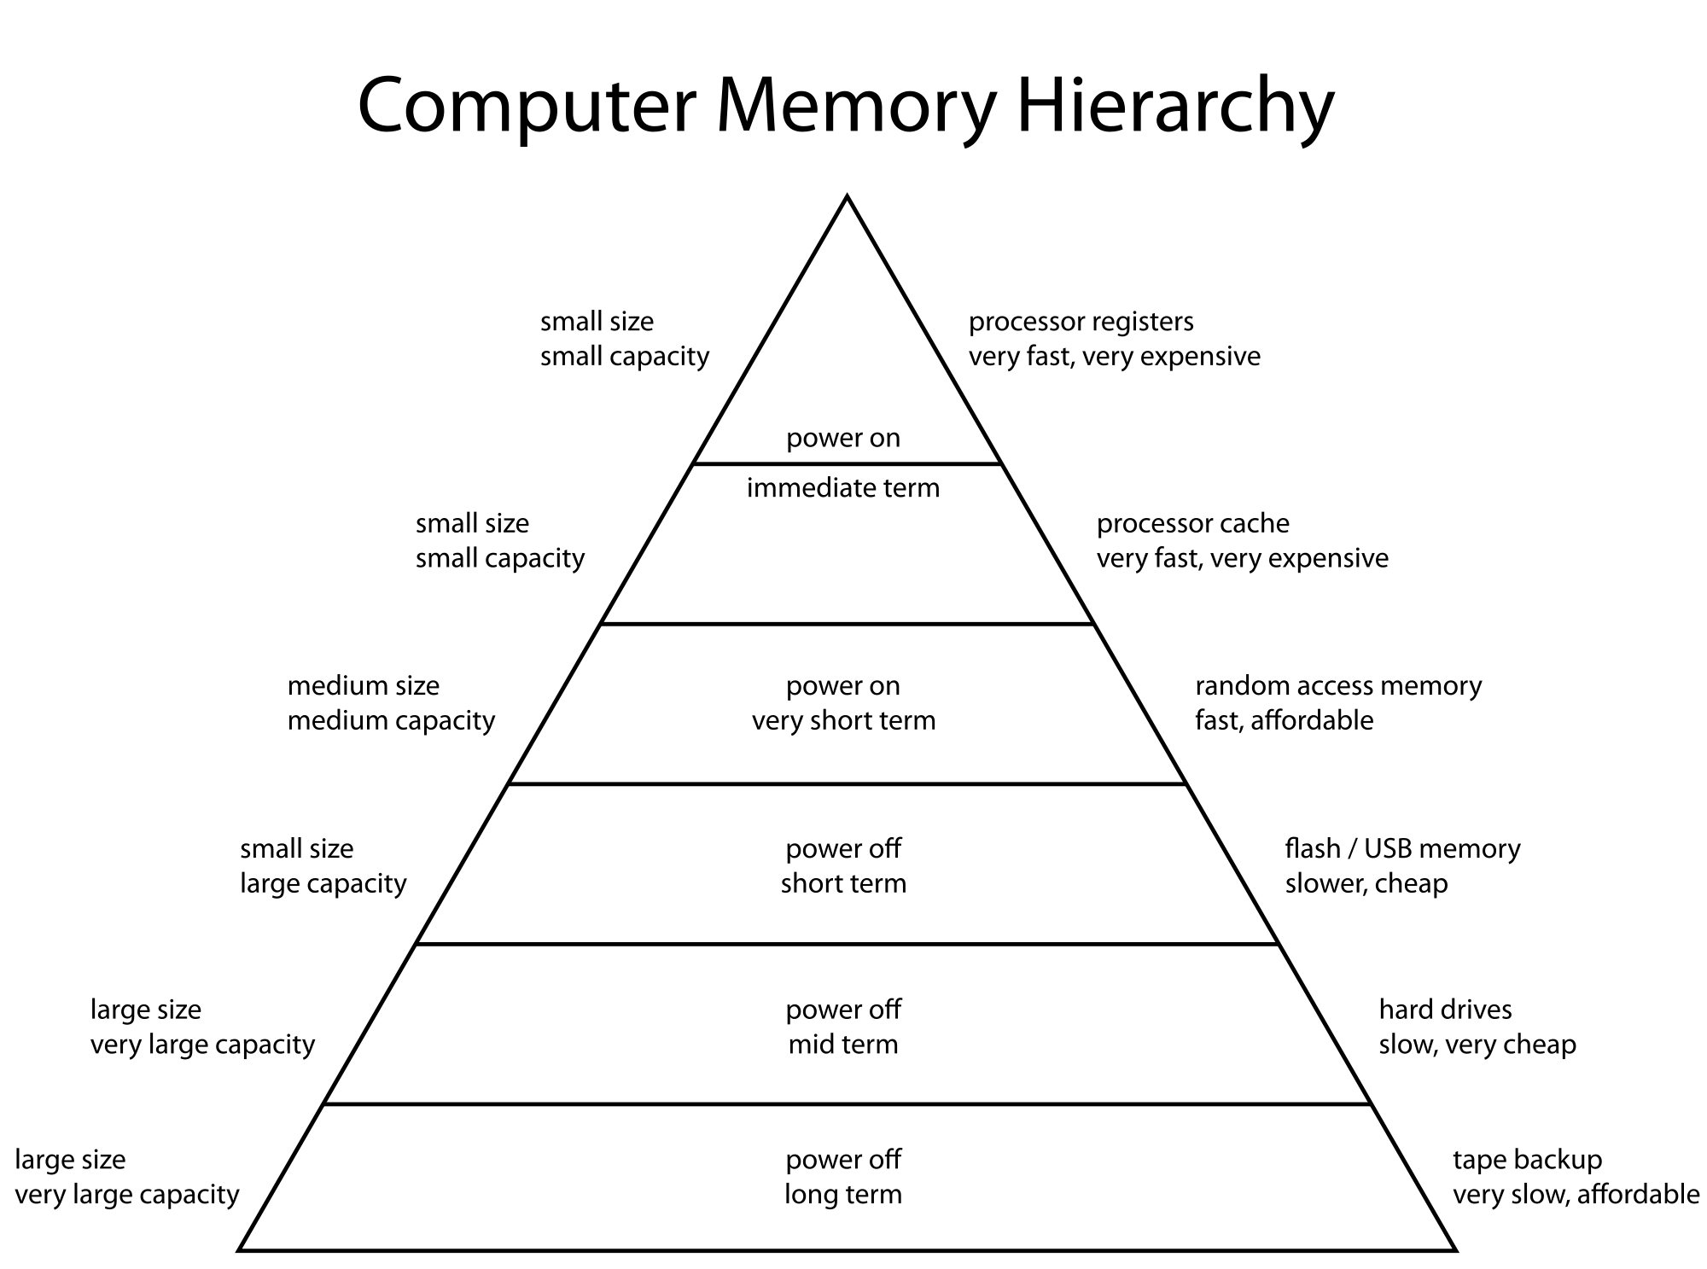
Today

Slide 19
Magnetic Disk – common I/O device
A kind of computer memory
Information stored by magnetizing ferrite material on surface of rotating disk
similar to tape recorder except digital rather than analog data
A type of non-volatile storage
retains its value without applying power to disk.
Two Types of Magnetic Disk
Floppy disks – slower, less dense, removable.
Hard Disk Drives (HDD) – faster, more dense, non-removable.
Purpose in computer systems (Hard Drive):
Long-term, inexpensive storage for files
“Backup” for main-memory. Large, inexpensive, slow level in the memory hierarchy (virtual memory)

Slide 20
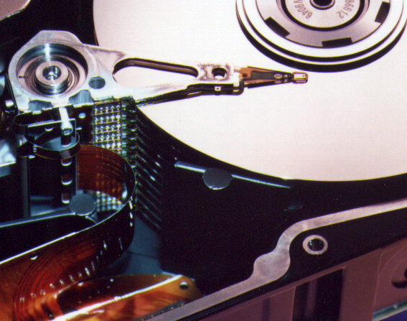
Photo of Disk Head, Arm, Actuator
Arm
Spindle
Head
Actuator
{
Platters (1-12)

Slide 21
Disk Device Terminology
Inner
Track
Arm
Head
Sector
Outer
Track
Several platters, with information recorded magnetically on both surfaces (usually)
Bits recorded in tracks, which in turn divided into sectors (e.g., 512 Bytes)
Actuator moves head (end of arm) over track (“seek”), wait for sector rotate under head, then read or write
Platter
Actuator
Notes:
arm interaction with platter

Slide 22
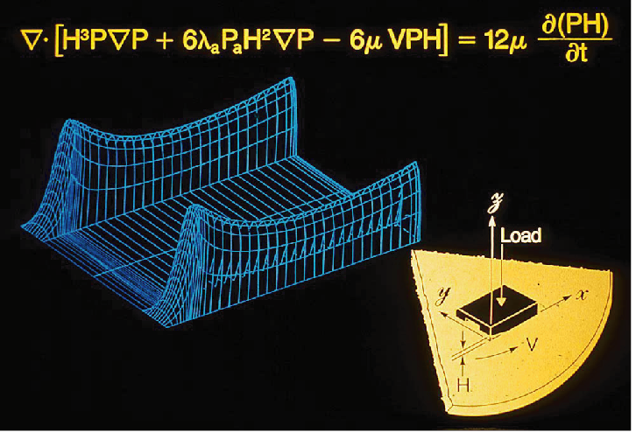
Hard Drives are Sealed. Why?
The closer the head to the disk, the smaller the “spot size” and thus the denser the recording.
Measured in Gbit/in^2
~900 Gbit/in^2 is state of the art
Started out at 2 Kbit/in^2
~450,000,000x improvement in ~60 years
Disks are sealed to keep the dust out.
Heads are designed to “fly” at around 5-20nm above the surface of the disk.
99.999% of the head/arm weight is supported by the air bearing force (air cushion) developed between the disk and the head.

Slide 23
Disk Device Performance (1/2)
Inner
Track
Sector
Head
Arm
Disk Access Time = Seek Time + Rotation Time + Transfer Time + Controller Overhead
Seek Time = time to position the head assembly at the proper cylinder
Rotation Time = time for the disk to rotate to the point where the first sectors of the block to access reach the head
Transfer Time = time taken by the sectors of the block and any gaps between them to rotate past the head
Outer
Track
Spindle
Controller
Platter
Actuator
Notes:
Use analogy to records

Slide 24
Disk Device Performance (2/2)
Average values to plug into the formula:
Rotation Time: Average distance of sector from head?
1/2 time of a rotation
7200 Revolutions Per Minute ⇒ 120 Rev/sec
1 revolution = 1/120 sec ⇒ 8.33 milliseconds
1/2 rotation (revolution) ⇒ 4.17 ms
Seek time: Average no. tracks to move arm?
Number of tracks/3 (see CS186 for the math)
Then, Seek time = number of tracks moved * time to move across one track

Slide 25
But wait!
Performance estimates are different in practice
Lots of “magic” going on behind the scenes in disks. One example:
Many disks have on-disk caches, which are completely hidden from the outside world
Previous formula completely replaced with on-disk cache access time

Slide 26
Where does Flash memory come in?
~5-10 years ago: Microdrives and Flash memory (e.g., CompactFlash) went head-to-head
Both non-volatile (no power, data ok)
Flash benefits: durable & lower power (no moving parts, need to spin µdrives up/down)
Disk cost = fixed cost of motor + arm mechanics, but actual magnetic media cost very low
Flash cost = most cost/bit of flash chips
Over time, cost/bit of flash came down, became cost competitive

Slide 27
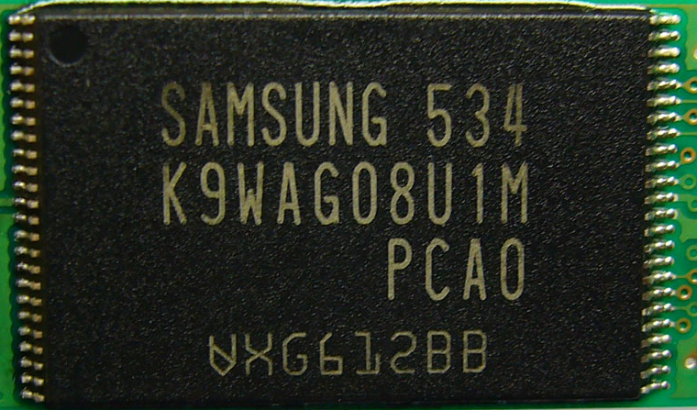
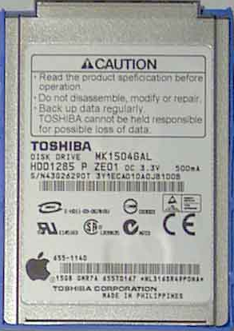
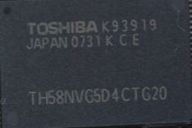
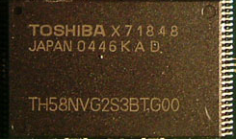
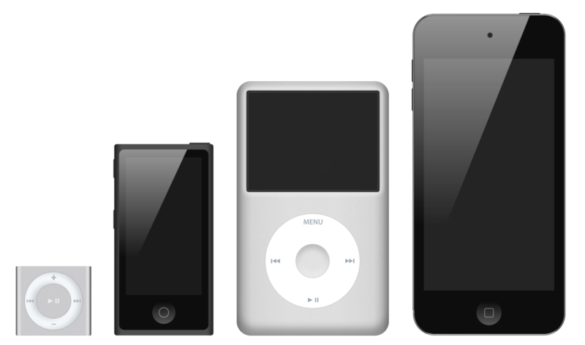
What does Apple put in its iPods?
Toshiba flash 2 GB
Samsung flash 16 GB
Toshiba 1.8-inch HDD 80, 120, 160 GB
Toshiba flash 32, 64 GB
shuffle nano classic touch

Slide 28
What does Apple put in its iPods?
Toshiba flash 2 GB
Samsung flash 16 GB
Toshiba 1.8-inch HDD 80, 120, 160 GB
Toshiba flash 32, 64 GB
shuffle nano classic touch

Slide 29
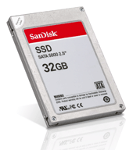
Flash Memory / SSDs
How does Flash memory work?
NMOS transistor with an additional conductor between gate and source/drain which “traps” electrons. The presence/absence is a 1 or 0
Requires complex management algorithms to avoid wearing out cells
Early SSDs had severe reliability issues due to poorly implemented firmware
More in CS162

Slide 30
iClicker Question
We have the following disk:
15000 Cylinders, 1 ms to cross 1000 Cylinders
15000 RPM = 4 ms per rotation
Want to copy 1 MB, transfer rate of 1000 MB/s
1 ms controller processing time
What is the access time using our model?
Disk Access Time = Seek Time + Rotation Time + Transfer Time + Controller Processing Time
A | B | C | D | E
10.5 ms | 9 ms | 8.5 ms | 11.4 ms | 12 ms

Slide 31
iClicker Question
We have the following disk:
15000 Cylinders, 1 ms to cross 1000 Cylinders
15000 RPM = 4 ms per rotation
Want to copy 1 MB, transfer rate of 1000 MB/s
1 ms controller processing time
What is the access time?
Seek = # cylinders/3 * time = 15000/3 * 1ms/1000 cylinders = 5ms
Rotation = time for ½ rotation = 4 ms / 2 = 2 ms
Transfer = Size / transfer rate = 1 MB / (1000 MB/s) = 1 ms
Controller = 1 ms
Total = 5 + 2 + 1 + 1 = 9 ms

Slide 32
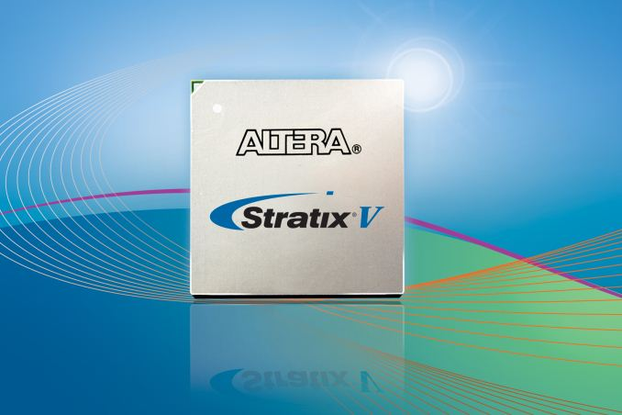
CS61C (and CS150) in the News
http://research.microsoft.com/apps/pubs/default.aspx?id=212001
Microsoft “Catapult”, ISCA 2014
FPGAs are “programmable” hardware used by computer architects and digital circuit designers, lie somewhere between CPUs and custom chips (ASICs).
“Microsoft published a paper at ISCA about using FPGAs in datacenters
for page ranking processing for Bing. In a test deployment, MS reported up to 95% more throughput for only 10% more power. The added TCO was less than 30%. Microsoft used Altera Stratix V FPGAs in a PCIe form-factor with 8GB of DDR3 RAM on each board. The FPGAs were connected using a 10Gb SAS network.” - AnandTech

Slide 33
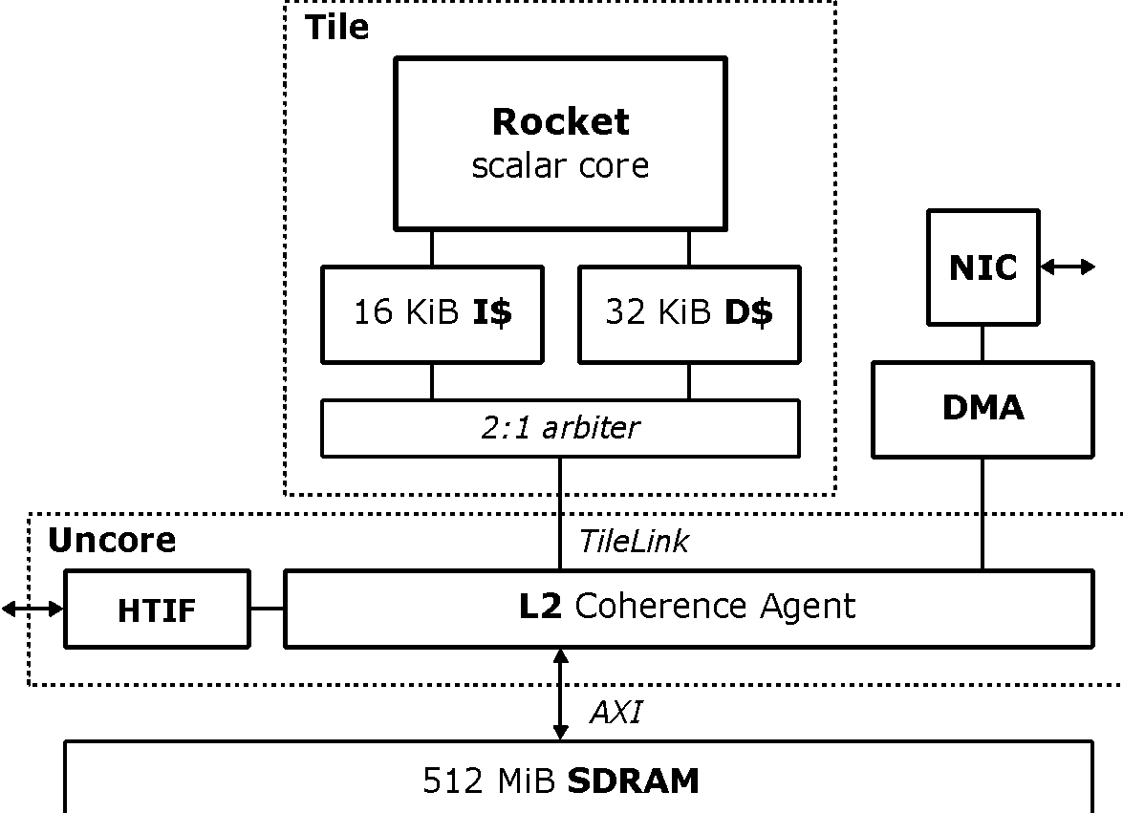
Hardware Acceleration of Key-Value Stores
Datacenter apps, path through CPU/kernel/app ≈ 86% of request latency
Goal: Serve popular Key-Value Store GET requests without CPU
Soft-managed cache attached to NIC, RoCC CPU interface
Benchmarking on FPGA:
RISC-V Rocket @ 50 MHz
NIC from TEMAC/PCS-PMA + 1 Gb SFP
Hardware KV-Store Accelerator
Traffic Manager, DMA Engine
Written in Chisel
Base System: First Physical RISC-V System with Networking Support
Sagar Karandikar
Howard Mao
Albert Ou
Yunsup Lee
Krste Asanovic

Slide 34
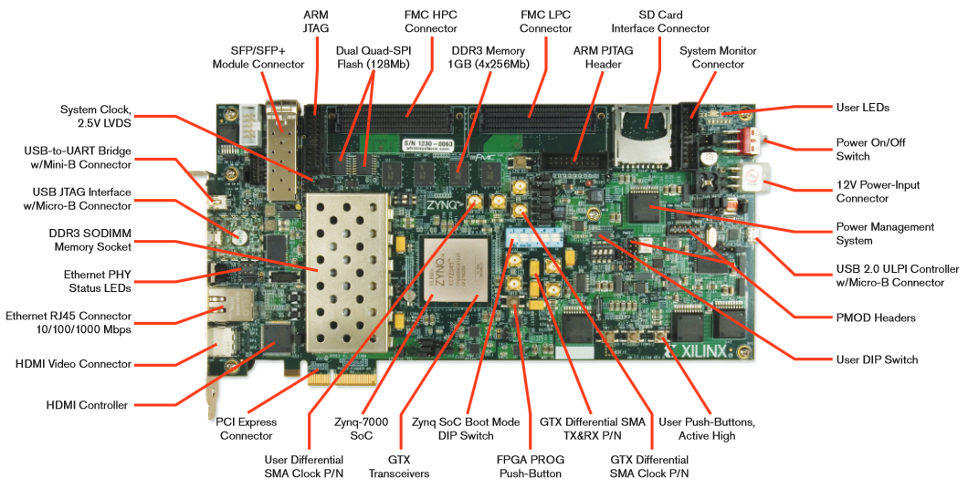
Hardware Acceleration of Key-Value Stores
Datacenter apps, path through CPU/kernel/app ≈ 86% of request latency
Goal: Serve popular Key-Value Store GET requests without CPU
Soft-managed cache attached to NIC, RoCC CPU interface
Benchmarking on FPGA:
RISC-V Rocket @ 50 MHz
NIC from TEMAC/PCS-PMA + 1 Gb SFP
Hardware KV-Store Accelerator
Traffic Manager, DMA Engine
Written in Chisel
Base System: First Physical RISC-V System with Networking Support
Sagar Karandikar
Howard Mao
Albert Ou
Yunsup Lee
Krste Asanovic

Slide 35
Break

Slide 36
Agenda
Direct Memory Access (DMA)
Disks
Networking

Slide 37
Networks: Talking to the Outside World
Originally sharing I/O devices between computers
E.g., printers
Then communicating between computers
E.g., file transfer protocol
Then communicating between people
E.g., e-mail
Then communicating between networks of computers
E.g., file sharing, www, …
Notes:
Original printers were the size of bathrooms - HAD to share
FTP was the first time file sharing happened
Communicating between people has become dominant, pervasive, ubiquitous
- Also IM
Last bullet is where a lot of research is happening

Slide 38
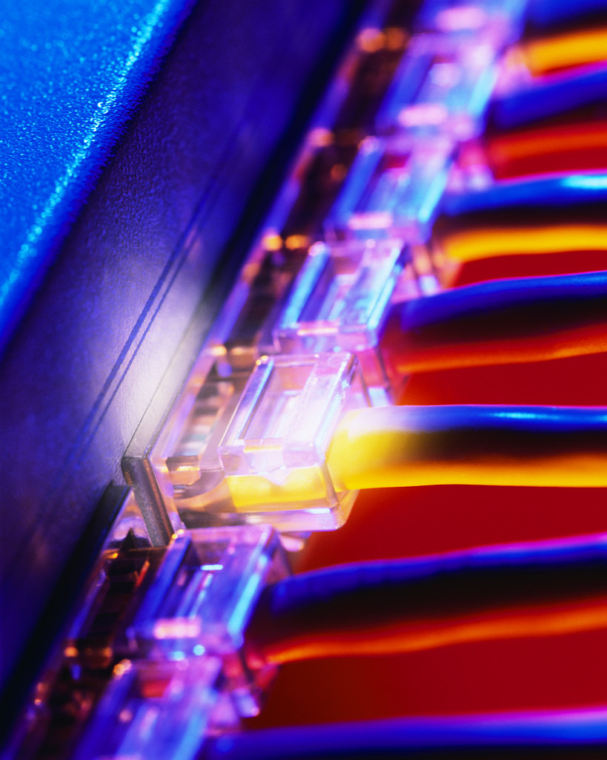
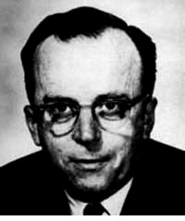
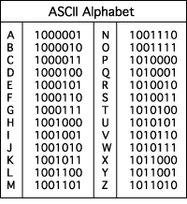
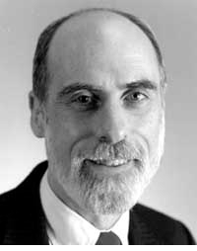
The Internet (1962)
www.computerhistory.org/internet_history
History
JCR Licklider, as head of ARPA, writes on “intergalactic network”
1963 : ASCII becomes first universal computer standard
1969 : Defense Advanced Research Projects Agency (DARPA) deploys 4 “nodes” @ UCLA, SRI, Utah, & UCSB
1973 Robert Kahn & Vint Cerf invent TCP, now part of the Internet Protocol Suite
Internet growth rates
Exponential since start!
“Lick”
Revolutions like this don't come along very often
Vint Cerf
www.greatachievements.org/?id=3736 en.wikipedia.org/wiki/Internet_Protocol_Suite

Slide 39
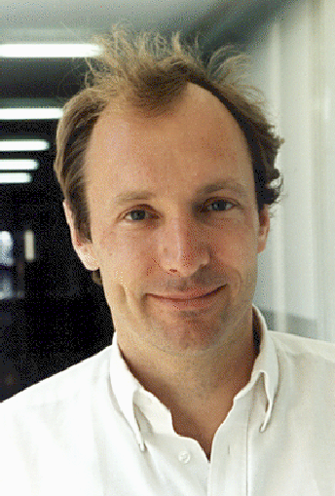
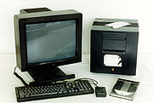
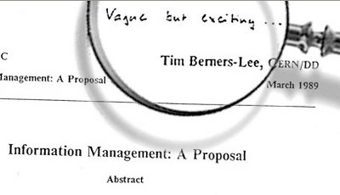
The World Wide Web (1989)
en.wikipedia.org/wiki/History_of_the_World_Wide_Web
“System of interlinked hypertext documents on the Internet”
History
1945: Vannevar Bush describes hypertext system called “memex” in article
1989: Sir Tim Berners-Lee proposes, gets system up ’90
~2000 Dot-com entrepreneurs rushed in, 2001 bubble burst
Wayback Machine
Snapshots of web over time
Today : Access anywhere!
World’s First web server in 1990
Tim Berners-Lee

Slide 40
Shared vs. Switch-Based Networks
Shared
Shared vs. Switched:
Shared: 1 at a time (CSMA/CD)
Switched: pairs (“point-to-point” connections) communicate at same time
Aggregate bandwidth (BW) in switched network is many times shared:
point-to-point faster since no arbitration, simpler interface
Node
Node
Node
Node
Crossbar
Switch
Node
Node
Node
Notes:
CSMA/CD = Carrier Sense Multiple Access / Collision Detection
Bus: On collision, have to wait random amount of time
Buses not used very much, inefficient.
Switches are much more efficient
Bandwidth is like throughput

Slide 41

What makes networks work?
links connecting switches and/or routers to each other and to computers or devices
Computer
switch
switch
switch
network
interface
ability to name the components and to route packets of information - messages - from a source to a destination
Layering, redundancy, protocols, and encapsulation as means of abstraction (61C big idea)
Notes:
Computer has Network Interface Card (NIC)
Sends message through the series of switches, which get the message to recipient
Usually draw the series of switches as the “Internet Cloud”
- Represents an abstraction, “don’t know” implementation
- Send the message through the network, and it will get to where it needs to go
Switches use routing tables to know how to get the message to the recipient

Slide 42
Software Protocol to Send and Receive
SW Send steps
1: Application copies data to OS buffer
2: OS calculates checksum, starts timer
3: OS sends data to network interface HW and says start
SW Receive steps
3: OS copies data from network interface HW to OS buffer
2: OS calculates checksum, if OK, send ACK; if not, delete message (sender resends when timer expires)
1: If OK, OS copies data to user address space, & signals application to continue
Dest
Src
Checksum
Net ID
Net ID
Len
ACK
INFO
CMD/ Address /Data
Header
Payload
Trailer
Notes:
Timer is counting down on Time To Live (TTL)
- You can see this in Pings

Slide 43

Networks are like Ogres
https://www.youtube.com/watch?v=_bMcXVe8zIs

Slide 44
Protocol for Networks of Networks?
What does it take to send packets across the globe?
Bits on wire
Packets on wire
Delivery packets within a single physical network
Deliver packets across multiple networks
Ensure the destination received the data
Do something with the data
Datalink
Network
Transport
Application

Slide 45
Protocol for Networks of Networks?
Abstraction to cope with complexity of communication
Networks are like ogres onions
Hierarchy of layers:
Application (chat client, game, etc.)
Transport (TCP, UDP)
Network (IP)
Data Link Layer (ethernet)
Physical Link (copper, wireless, etc.)
Networks are like onions.
They stink?
Yes. No!
Oh, they make you cry.
No!… Layers. Onions have layers. Networks have layers.
Notes:
WS companies used TCP/IP even over LAN
Because early Ethernet controllers were cheap, but not reliable

Slide 46
Protocol Family Concept
Key to protocol families is that communication occurs logically at the same level of the protocol, called peer-to-peer… …but is implemented via services at the next lower level
Encapsulation: carry higher level information within lower level “envelope”

Slide 47
Inspiration…
CEO A writes letter to CEO B
Folds letter and hands it to assistant
Assistant:
Puts letter in envelope with CEO B’s full name
Takes to FedEx
FedEx Office
Puts letter in larger envelope
Puts name and street address on FedEx envelope
Puts package on FedEx delivery truck
FedEx delivers to other company
Dear John,
Your days are numbered.
--Pat

Slide 48
The Path of the Letter
“Peers” on each side understand the same things
No one else needs to
Lowest level has most packaging
CEO
Semantic Content
CEO
Letter
Identity
Aide
Envelope
Aide
Location
FedEx
Fedex Envelope (FE)
FedEx

Slide 49
The Path Through FedEx
Truck
Truck
FE
FE
FE
Sorting
Office
Sorting
Office
Sorting
Office
New
Crate
Crate
Crate
Crate
Airport
Airport
Airport
Deepest Packaging (Envelope+FE+Crate)
at the Lowest Level of Transport

Slide 50
Protocol Family Concept
Message
Logical
Message
Actual
Actual
Logical
H
Message
T
H
Message
T
Actual
Actual
H
H
Message
T
T
H
H
Message
T
T
Physical

Slide 51
Protocol for Network of Networks
Transmission Control Protocol/Internet Protocol (TCP/IP) (TCP :: a Transport Layer)
This protocol family is the basis of the Internet, a WAN protocol
IP makes best effort to deliver
Packets can be lost, corrupted
TCP guarantees delivery
TCP/IP so popular it is used even when communicating locally: even across homogeneous LAN
Notes:
WS companies used TCP/IP even over LAN
Because early Ethernet controllers were cheap, but not reliable
TCP and IP fundamentally different but very connected
TCP hires IP guys
- GO!
- IP guy falls into a hole
- TCP hires another IP guy
- GO!
-IP gus falls into a hole
- Hire another!

Slide 52
TCP/IP packet, Ethernet packet, protocols
Application sends message
Ethernet Hdr
TCP breaks into 64KiB segments, adds 20B header
IP Header
TCP Header
EH
IP Data
IP adds 20B header, sends to network
TCP data
If Ethernet, broken into 1500B packets with headers, trailers
Message
Ethernet Hdr

Slide 53
“And in conclusion…”
I/O gives computers their 5 senses
I/O speed range is 100-million to one
Polling vs. Interrupts
DMA to avoid wasting CPU time on data transfers
Disks for persistent storage, replaced by flash
Networks: computer-to-computer I/O
Protocol suites allow networking of heterogeneous components. Abstraction!!!
Acknowledgement: Some Networking slides adapted from CS168

